Slide 1

HPC Programming Practices – an introduction
First Computational Physics School for Fusion Research 2019
MIT, Cambridge, MA
John Wright
jcwright@mit.edu
Notes:
Not a tutorial on linux, but focussed on using hpc.

Slide 2
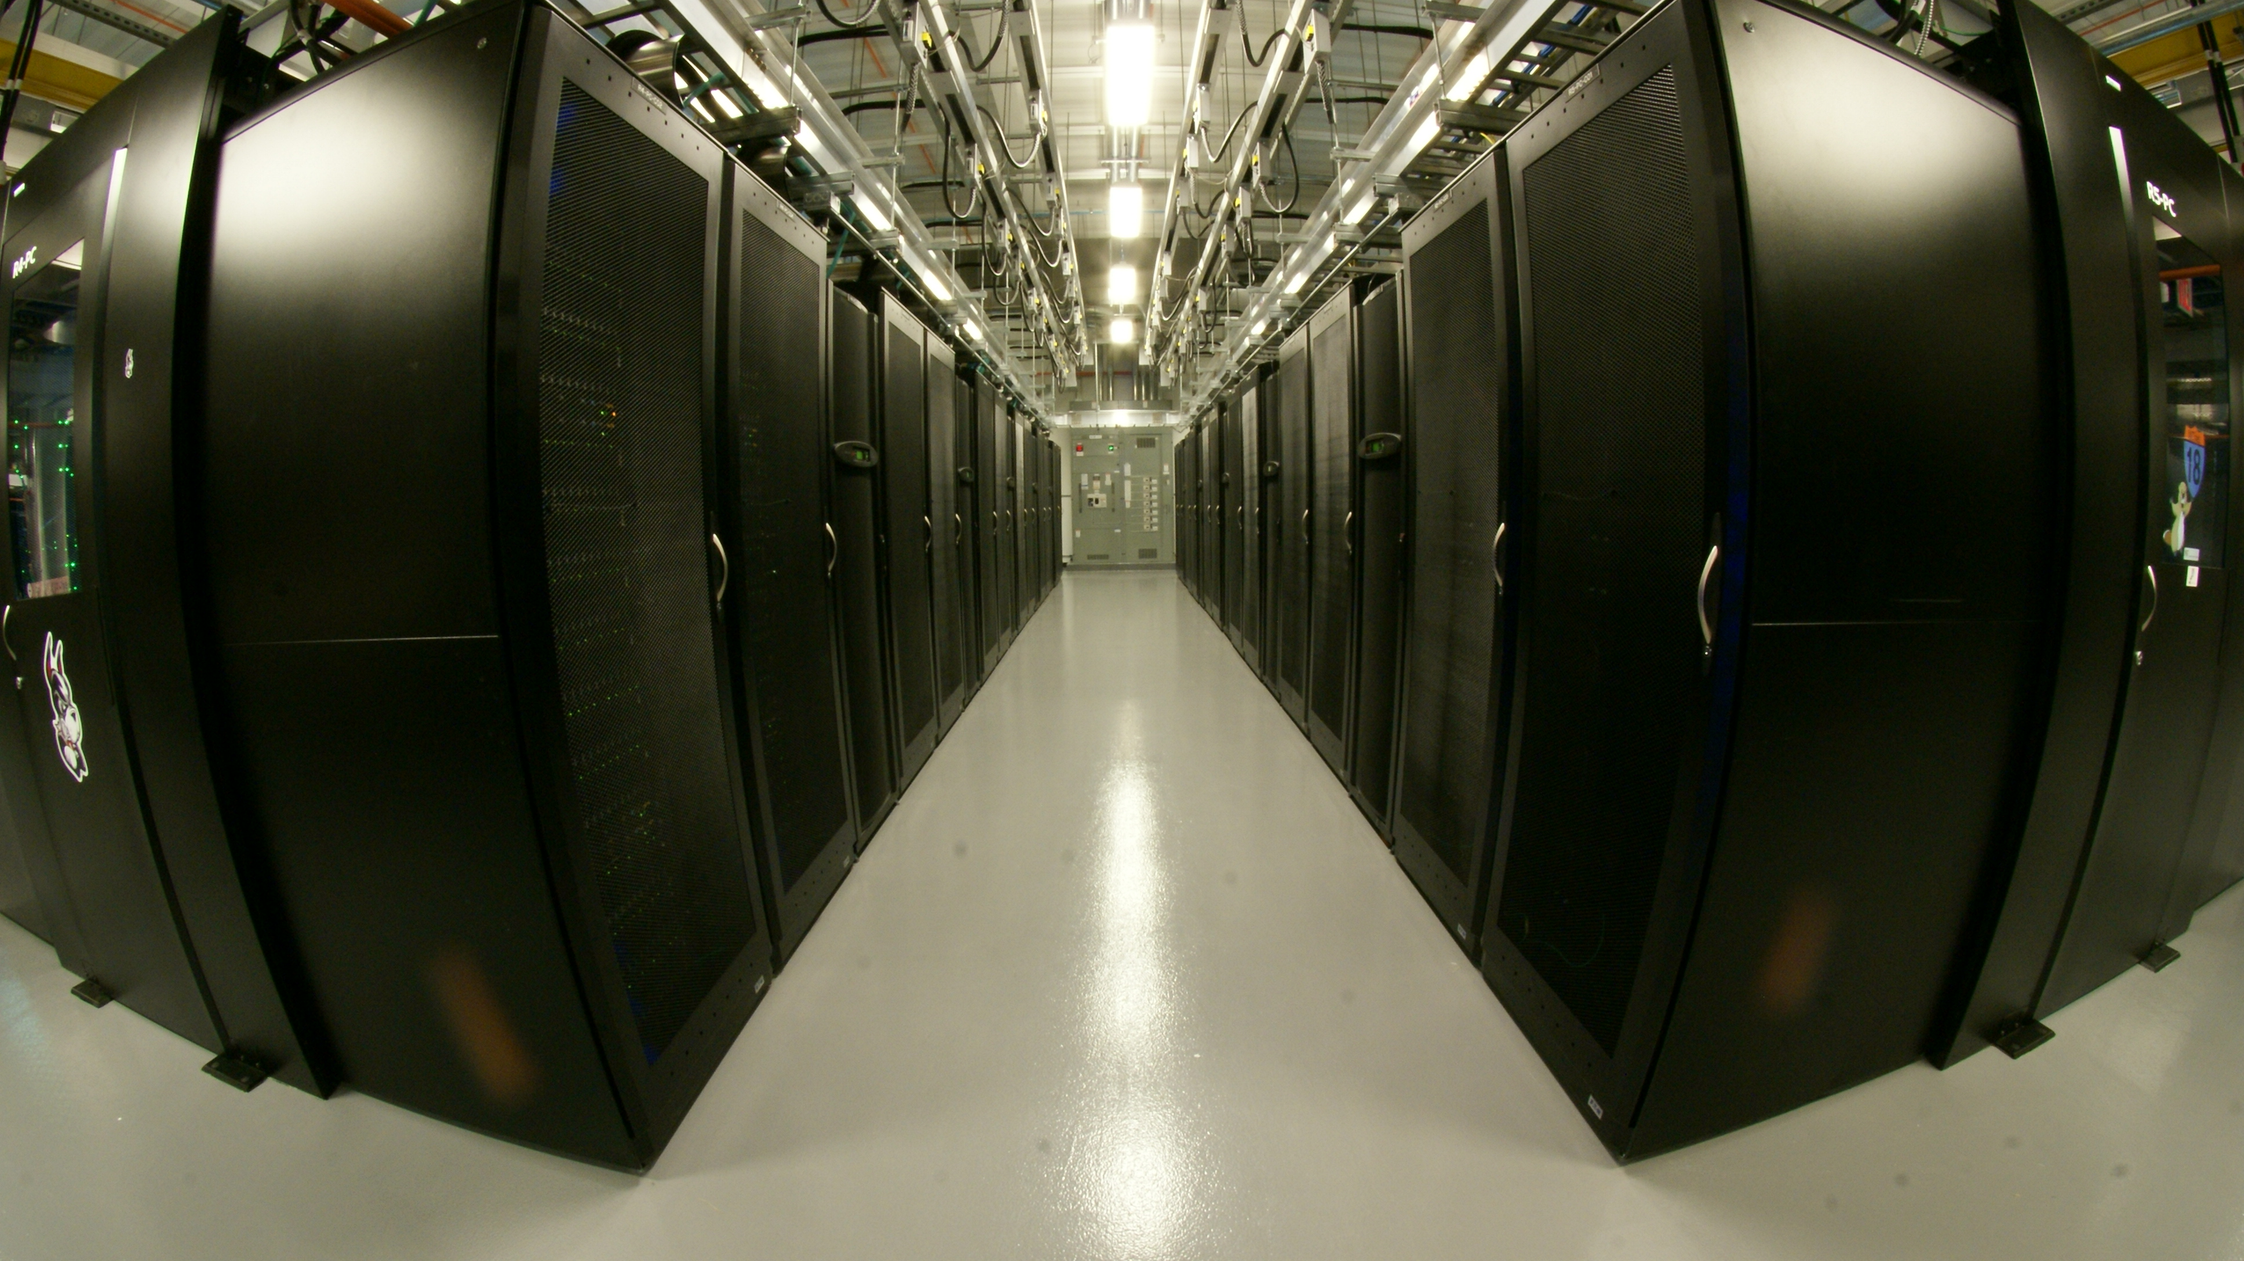
The Engaging system, eofe[78].mit.edu
PSFC partition has 100 nodes, 3200 cores running Centos 7 , 2x16 cores Intel Xeon 2.1 GHz, 128 GB RAM
Older system nodes run Centos 6 (eofe6) and have 16 cores per node.
For the CPS-FR week we have 50 nodes exclusive in the cpsfr partition: [eoef7]$ getent group sched_mit_psfc_cpsfr Much of first half of talk is drawn from: https://github.com/jcwright77/engaging_cluster_howto/blob/master/README.md
Notes:
If you don’t see your username there, you have not got your account yet.

Slide 3
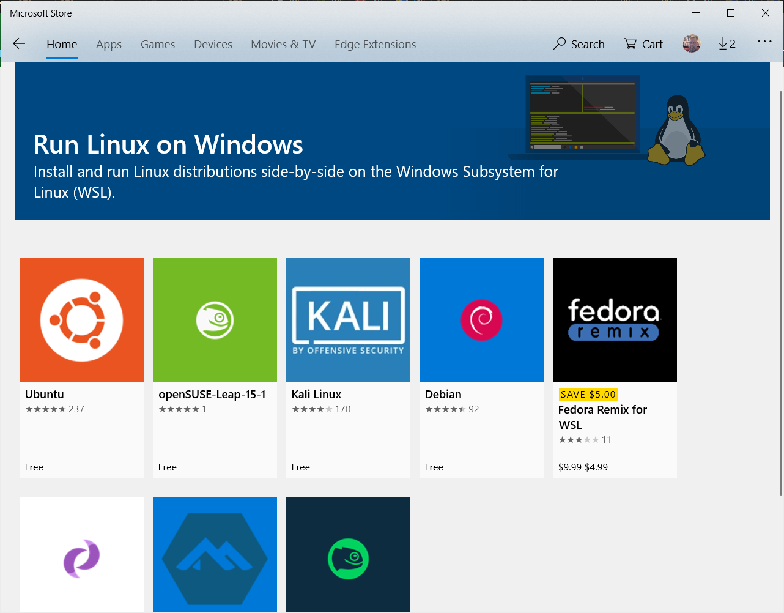
Your computer
All your base are belong to us - Linux

Slide 4
Use linux in MS-Windows and OSX
Windows
OSX
Microsoft store, search for Ubuntu or OpenSuse or Debian and install
All run in the Windows Subsystem for Linux (WSL) and can run side by side
Add your favorite linux apps and tools with the appropriate package manager (eg apt-get for Ubuntu)
X11 server also comes with Windows MobaXterm program which is WSL (and putty and SecureCRT) aware
Native BSD unix
Need to add X11 (XQuartz)
Pick and add a package manager (macports, fink, brew)

Slide 5

Connecting . . .
Terminal and desktop connections

Slide 6

SSH keys: passphrases and not passwords.
What is the difference?
There is a key *pair*. A private key on the connecting computer and a public key on the server you are connecting to. The passphrase decrypts the local private key. The public-private key pair is then used to establish an encrypted channel. A password hash is stored on the server. You only need the password to connect.
Nersc sshproxy.sh, how does it work?
Nersc used to let you set your own ssh keys through nim.nersc.gov. This prevents permanent empty passphrase keys.
Creates passphrase free keys and posts them to nersc authenticating with your password and multi-factor authentication (MFA). Keys are good for 24hrs.
Notes:
Ssh keys are the source of the most problems in accessing HPC systems.

Slide 7
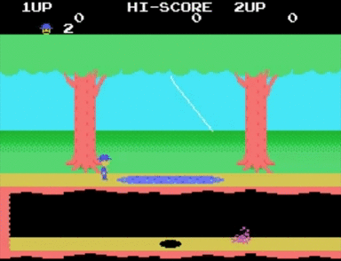
SSH pitfalls
Permissions on keys
Linux requires the keys and directory only be readable by the user (chmod 600 or 700 permissions)
Each client machine must have a copy of the private key, ie you cannot connect from your friend’s laptop before copying your key over – which you should probably not do.
Target server must have public key copy appended to $HOME/.ssh/authorized_keys and sometimes a copy in $HOME/.ssh/ itself with correct permissions.
Wrong or forgotten passphrase, using wrong key
Notes:
Ssh keys are the single most common issue when setting up new users on HPC systems.

Slide 8
Exercise: ssh keys
Try it: Make, verify and use ssh key with passphrase see gist: https://gist.github.com/jcwright77/7d5a934338140af025eba6f6e0868c32
Do it: Add a new key for logging in to engaging.
Show it: nersc sshproxy.sh
Notes:
Demo nersc.

Slide 9
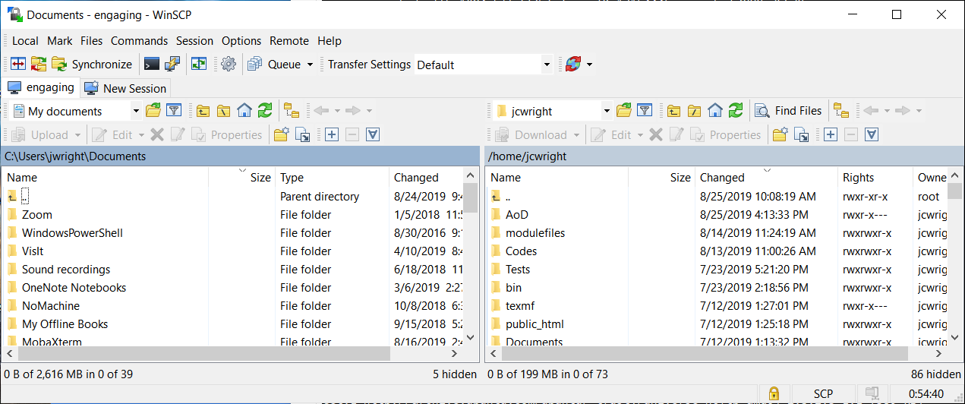
File Transfers
scp at bash prompt is the most universal
scp file user@eofe7.mit.edu:<opt remote path>
scp –rp dir user@eofe7.mit.edu:
scp user@eofe7.mit.edu:file .
Gui such as WinSCP, Filezilla, Cyberduck
Notes:
Brie

Slide 10
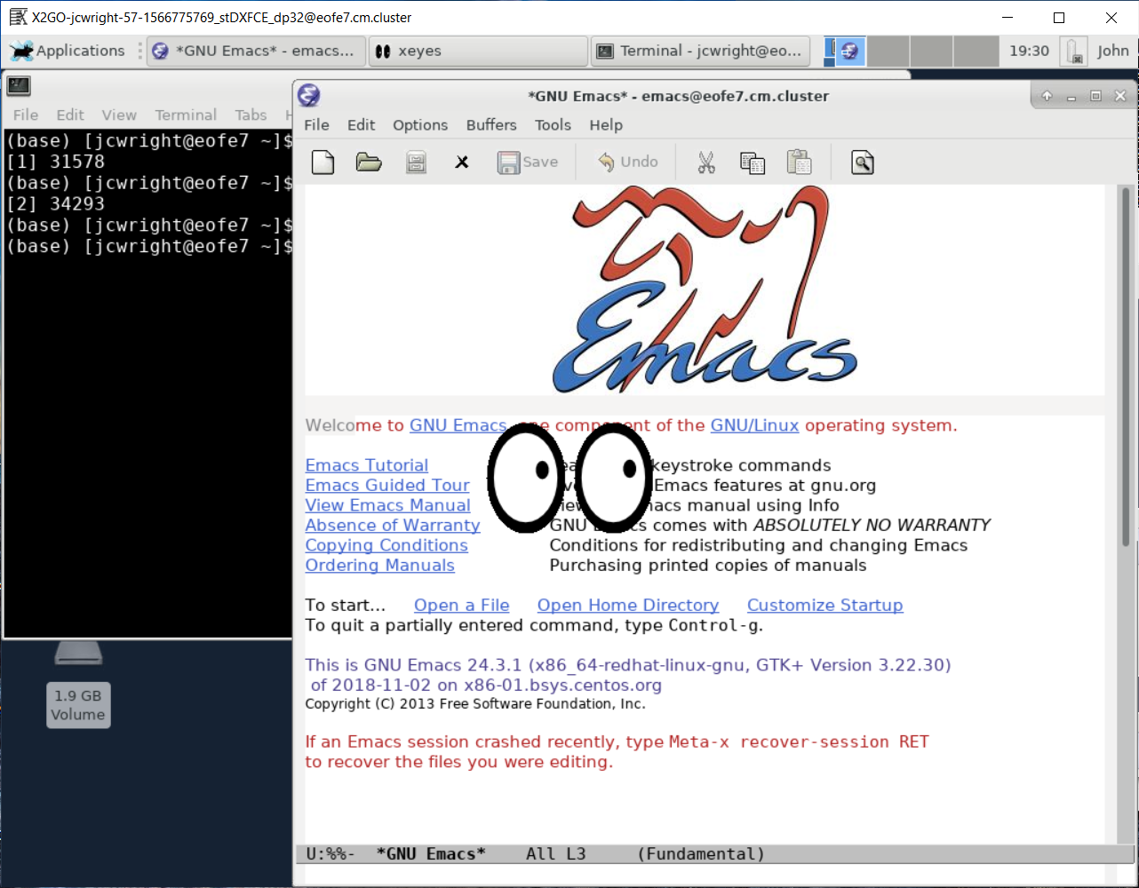
Persistent remote desktop connections
Nomachine/x2go https://wiki.x2go.org/doku.php/start
Same code base.
Both can use ssh keys
Nomachine requires a license, used at Nersc,psfc
Try x2go on engaging
FastX, try it now!
Web client.
Connect to eofe[78].mit.edu and add private key to your browser (stored in local cache)
X11 forwarding
Not persistent
Tends to be much slower
Individual clients on your local desktop
With X11 server such as MobaXterm (Windows), Xquartz (OSX), XWin32 (Windows, licensed) ssh –Y user@eofe7.mit.edu

Slide 11
Environment modules
Standard way of selecting software versions

Slide 12
Load modules to control which software and libraries you use
Provide a clean way of managing multiple compiler/MPI combinations, software versions and dependencies. Modules modify search paths and other environmental variables in a user's shell so the executables and libraries associated with a module are found.
module avail - list all modules currently available on the system
module show - show what environment a module loads
module add/unload - add/remove a module from a user's environment
module list - list what modules are loaded
module purge - remove all loaded modules
module use - add a new search path to modules

Slide 13
What does a module look like
An example module file #%Module -*- tcl -*-
##
## dot modulefile
##
proc ModulesHelp { } {
puts stderr "\tAdds FFTW2 library for 64 bits to your environment."
puts stderr "\tDirectory:/home/software/psfc/pkg/fftw/2.1.5/intel-17/impi"
}
module-whatis "Adds FFTW2 library for 64 bits to your environment. Built with intel compiler."
conflict psfc/fft/2.1.5
prereq intel
set root /home/software/psfc/pkg/fftw/2.1.5/intel-17/impi
prepend-path LD_RUN_PATH $root/lib
prepend-path INCLUDE_PATH $root/include
prepend-path LD_LIBRARY_PATH $root/lib
prepend-path INFOPATH $root/info
setenv FFTWDIR $root/lib
setenv FFTWINCLUDE $root/include
setenv FFTWLIB $root/lib
setenv FFTWVERSION 2.1.5
You can make your own mkdir $HOME/modulefiles module use $HOME/modulefiles module avail #you should see yours in this list

Slide 14
Another example that also loads modules.
An example module file #%Module -*- tcl -*-
proc ModulesHelp { } {
puts stderr "Triangle generates triangulations and voronoi meshes."
}
conflict triangle
set name Triangle
set version 1.6
set psfc_home /home/software/psfc
module-whatis "Name : $name"
module-whatis "Version : $version"
module-whatis "Category : code, meshing"
module-whatis "Provides : triange, showme, tricall"
module-whatis "Description : Triangle generates triangulations and voronoi meshes. Compiled with intel cc"
set root $psfc_home/pkg/$name
prepend-path PATH $root
setenv TRIHOME $root
setenv TRIANGLE_VERSION $version
#For codes, we load needed modules
if {[module-info mode] == "load"} {
if {![is-loaded psfc/config]} {
module load psfc/config
}
if {![is-loaded intel/2017-01]} {
module load intel/2017-01
}
}

Slide 15
Module use, examples
Module path names: category/package/optional attribute/version
Eg: psfc/netcdf/intel-17/4.4.1.1 a psfc module for netcdf, compiled by intel 2017, version 4.4.1.1
Categories are typically accessed/added with use module use /home/software/psfc/modulefiles
Version can be omitted and default (typically latest one) will be loaded
module avail julia julia/0.6.0 julia/0.6.2 julia/1.1.0
Search for a module
module avail <name> #searches for module beginning with <name>
module whatis <string> #searches for string mentioned in what-is strings
module avail |& grep <string> #searches all modules for name containing <string>

Slide 16

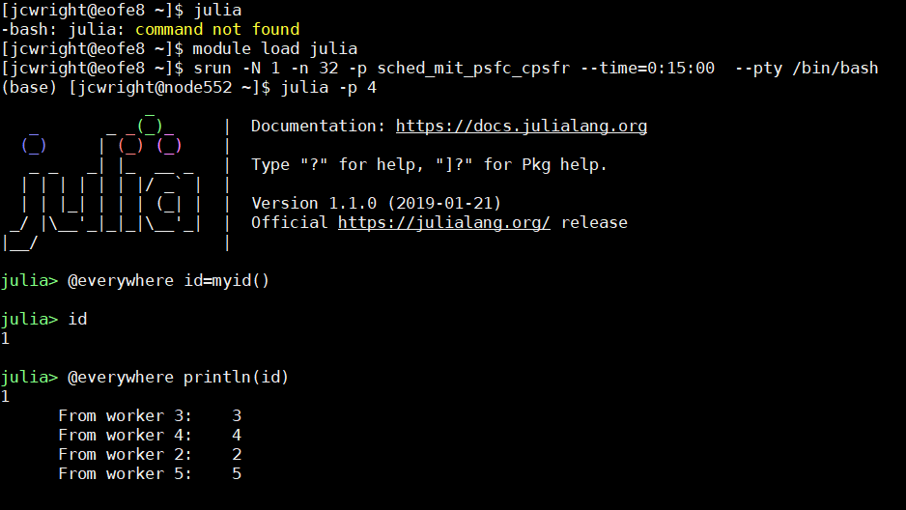
Run an example program
--reservation=psfc-cpsfr

Slide 17
Good practices with modules
Have your scripts load their environment via modules, this creates a reproducible environment for debugging. Start with “module purge” to avoid an inherited environment.
When reporting issues, include your loaded environment with module list
Modules define environmental variables with paths, useful in building software, eg makefiles module use /home/software/psfc/modulefiles module show psfc/hdf5

Slide 18
module show psfc/hdf5
[jcwright@eofe8 ~]$ module show psfc/hdf5
-------------------------------------------------------------------
/home/software/psfc/modulefiles/psfc/hdf5/intel-17/1.10.0:
conflict hdf5
module-whatis HDF5 1.10.0 Hierarchical Data Format library. api-version=v110
prepend-path PATH /home/software/psfc/pkg/hdf5-1.10.0-patch1/intel-17/bin
prepend-path LD_LIBRARY_PATH /home/software/psfc/pkg/hdf5-1.10.0-patch1/intel-17/lib
prepend-path INCLUDE_PATH /home/software/psfc/pkg/hdf5-1.10.0-patch1/intel-17/include
prepend-path CPATH /home/software/psfc/pkg/hdf5-1.10.0-patch1/intel-17/include
setenv HDF5_VERSION 1.10.0
setenv HDF5_LIB /home/software/psfc/pkg/hdf5-1.10.0-patch1/intel-17/lib
setenv HDF5_INC /home/software/psfc/pkg/hdf5-1.10.0-patch1/intel-17/include
-------------------------------------------------------------------

Slide 19

Queues and Partitions
Or, “Why isn’t my job running?”

Slide 20
Resource allocation, waiting your turn
Simple Linux Utility for Resource Management (SLURM)
Popular manager/queue system used on Engaging and at Nersc
More robust and flexible than some older systems such as Torque/Maui
Priorities for jobs are set by selectable criteria
At Nersc, priorities influence by job size, user set priority (and charge factor)
On Engaging, there are no charge accounts, so job priority is set by Fair Use factor and wait time.
Backfill
When a lower priority job can fit in between the gaps of larger jobs
E.G. There are 5 idles nodes. The system is waiting 45 min for a 2 node job to finish so it can allocate 7 nodes to the next higher priority job. A low priority job that has requested 4 nodes for 30 min runs right away but a higher priority job asking for 4 nodes for 50 minutes does not.
Lesson: shorter jobs may run sooner. Don’t request 12hr for every single job irregardless of actual runtime.

Slide 21
Slurm commands
sbatch :: submit a batch job
squeue -u username :: show a users job status
scancel :: kill a job
scontrol show partition :: list partitions to which you have access
scontrol show jobid # :: info on job
sinfo -a :: show all partition names, runtimes and available nodes
salloc :: request a set of nodes in a partition salloc --gres=gpu:1 -N 1 -n 16 -p sched_any --time=1:00:00 --exclusive You must exit from an salloc session. srun and mpirun within an allocation will use the allocated cores automatically
srun :: run a program on allocated processors, optionally, also requests the allocation if needed.
sacct :: detailed information on usage

Slide 22
SLURM examples
Partitions.
They contain node resources with possible inhomogenous properties
Nodes may belong to more than one partition
List partitions you have access to
sinfo Partition for this class is sched_mit_psfc_cpsfr Use sinfo to show number of nodes
Partition details
sinfo -p sched_mit_psfc_cpsfr –long
Start a shell on a allocated node
srun -N 1 -n 32 -p sched_mit_psfc_cpsfr --time=0:15:00 --reservation=psfc-cpsfr –-x11=first --pty /bin/bash
Job execution order is determined by your priority
squeue -p sched_mit_psfc -o "%.15i %.20P %.20j %.15u %.15T %.10M %.8C %.9l %.6D %R %q %Q %.30S“ JOBID NAME USER STATE TIME CPUS TIME_LIMI NODES PRIORITY NODELIST(REASON)
21345140_[6] 5284 sciortino PENDING 0:00 256 12:00:00 8 225 (Dependency)
21356895 submit.slurm stlam PENDING 0:00 192 12:00:00 6 57 (Priority)
21355729 submit.slurm stlam PENDING 0:00 160 12:00:00 5 57 (Resources)
21344166 gkyl milanese RUNNING 21:08:41 64 1-00:00:00 2 2923 node[592-593]

Slide 23
Run a job in slurm
git clone https://gist.github.com/e7314b16bf3c9982e9fe771b034a911d.git cpsfr-cpi or go to https://gist.github.com/jcwright77 and select gist with comment “CPS-FR job example”
cd cpsfr-cpi
module load gcc mpich/ge/gcc/64/3.1
mpicc cpi.c –o cpi
sbatch cpi_cpsfc.slurm Process 29 on node552.cm.cluster
Process 26 on node552.cm.cluster
. . .
pi is approximately 3.1415926536674030, Error is 0.0000000000776099
wall clock time = 0.052013

Slide 24
Any questions?

Slide 25
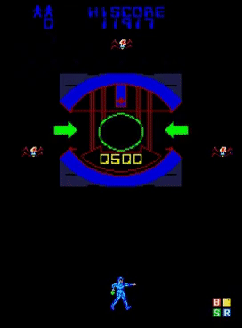
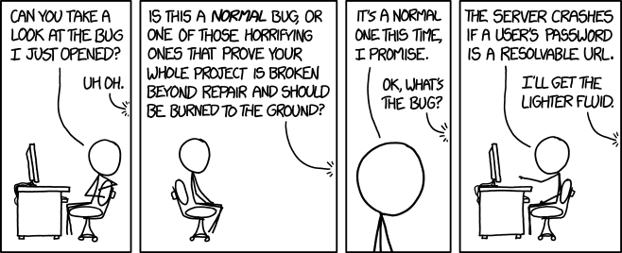
Basics of Debugging
Obligatory xkcd (xkcd/1700)

Slide 26
General principles
Reproducibility
Big bugs are better
Finding the bug, may be in
The program
Run time and compile time.
Whether crash or logic error, binary search with watch points or print statements.
The system
The inputs
The compiler

Slide 27
Bugs from resource usage
Know what resources your code requires
size <program> , will tell you the static allocation
top, will show RSS (resident set size) for running programs which is actual active memory usage, less than allocated memory.
Note, shared library usage counts towards RSS even though it may be actually split among several processes
How much memory does it allocate?
How much disk space does it use?
Do you have a quota?
How big is it? Or, if no quota, how much space on the file system? Most file systems suffer performance about 80% usage. Is I/O parallel? If so, are you running on a high performance file system (eg, not NFS).

Slide 28
Exercise: See RSS vs VSZ
[jcwright@node530 AoD]$ ./rss_usage_eg
0 GiB
VSZ RSS COMMAND
16781440 360 main.out
4 GiB
VSZ RSS COMMAND
16781440 4196244 main.out
8 GiB
VSZ RSS COMMAND
16781440 8390548 main.out
12 GiB
VSZ RSS COMMAND
16781440 12584852 main.out
16 GiB
VSZ RSS COMMAND
16781440 16777488 main.out
i = 0x400001000
done
Run rss_usage_eg.c from https://github.com/jcwright77/AoD.git
Get source git clone https://github.com/jcwright77/AoD.git
Load compiler module load gcc/6.2.0
Compile gcc -ggdb3 -O0 -std=c99 -Wall -Wextra -pedantic -o rss_usage_eg rss_usage_eg.c
Allocate interactive job srun -p sched_mit_psfc_cpsfr --tasks-per-node=32 -N 1 --pty -t 0-2:05 bash
Run ./rss_usage_eg
Bonus points, run top in separate window and monitor process usage
Notes:
This step combines several concepts from the last session.

Slide 29
Symbols
Libraries and paths and name mangling

Slide 30
Variables and routines are renamed, mangled
nm cpi List symbols. Note function ‘f’ is defined (“T”), fprintf is undefined “U” as are MPI commands.
ldd cpi List dynamic dependencies.
We see that dynamic libraries linked in at run time define the missing symbols.
0000000000400986 T f
0000000000400c94 T _fini
U fprintf@@GLIBC_2.2.5 U MPI_Bcast
U MPI_Comm_rank
libgcc_s.so.1 => /home/software/gcc/6.2.0/lib64/libgcc_s.so.1 libmpich.so.12 => /cm/shared/apps/mpich/ge/gcc/64/3.1/lib/libmpich.so.12
Notes:
Where are undefined symbols defined? When a compile or program fails complained about undefined symbols, this is a way to find them.

Slide 31
Why used shared libraries?
Could just static link at compile time – all symbols in binary. This uses more memory especially for parallel codes with x copies of binary in memory.
Need to make sure that shared libraries are in the path $LD_LIBRARY_PATH (this is what modules do) -rpath at compile time
Can update minor library versions without recompiling, if API does not change or even inject replacements with $LD_PRELOAD
LDD Tricks. Try LD_DEBUG=files when running dynamic executable “LD_DEBUG=help cat” will give all options.

Slide 32
Debuggers

Slide 33
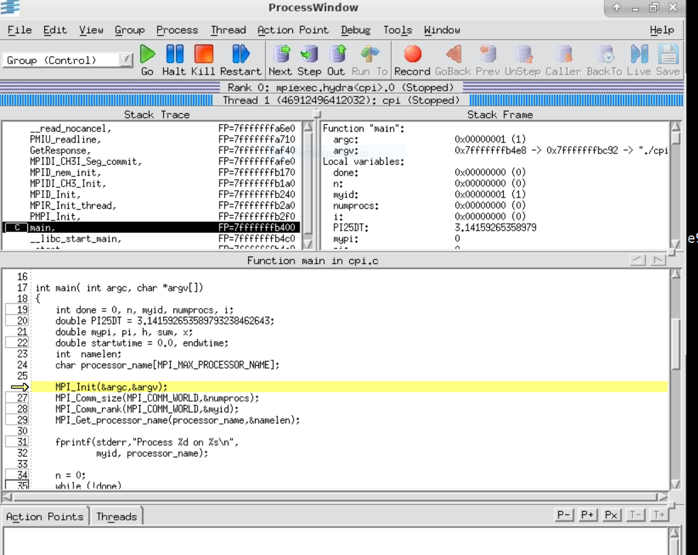
Totalview for parallel debugging
module use /home/software/psfc/modulesfiles module load psfc/totalview mpicc -g … mpirun –tv –np 4 ./cpi
Can set breakpoints graphically
View local values
“Dive” into variables to look at scope across processes.

Slide 34
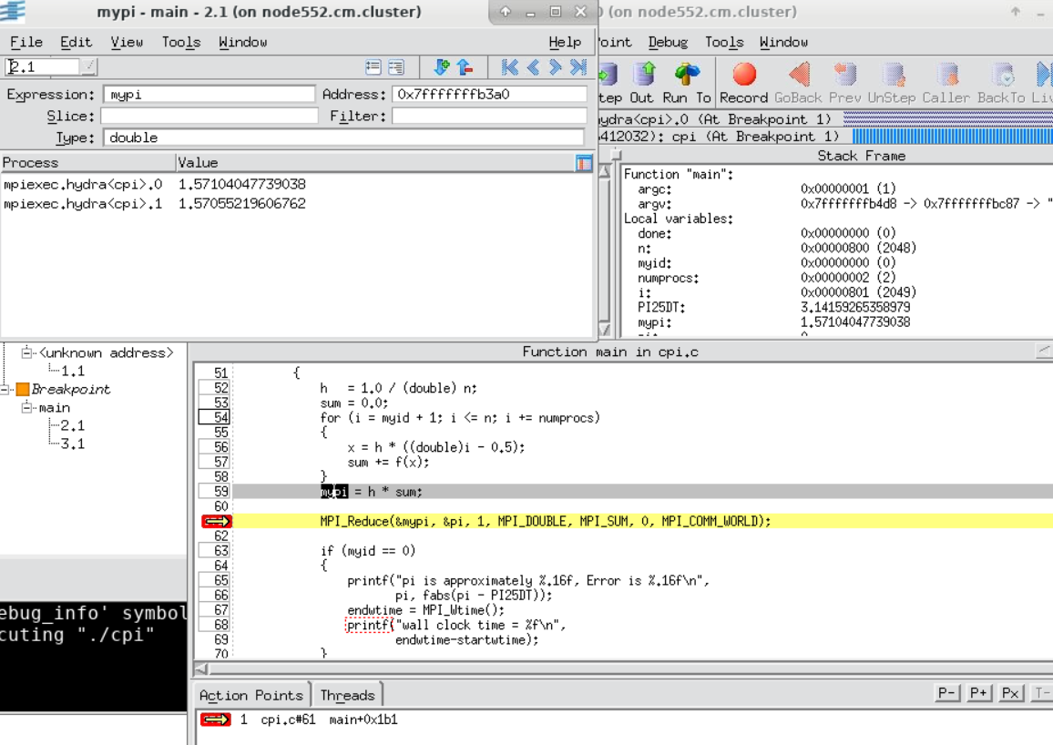
Totalview cont.

Slide 35
Summary
A fair amount of debugging workflows are understanding how symbols are resolved
Getting your job to run, and getting past bottlenecks requires understanding resources needed and available
Diagnosing errors in parallel codes is helped by a visual parallel debugger such as totalview

Slide 36
Thanks for your attention! Questions?

